Slide 1
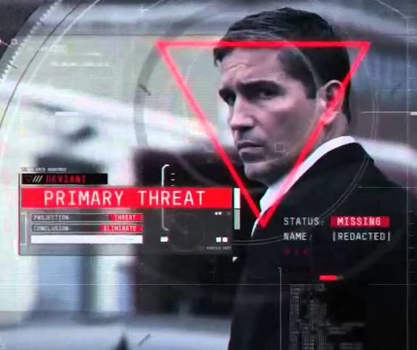
FACE RECOGNITION MODEL

Slide 2
WHY FACE RECOGNITION MODEL
One image to identify a person on an image, group image or video
Face App and personal data usage permission (90 million people: “a perpetual, irrevocable, nonexclusive, royalty-free, worldwide, fully-paid, transferable sub-licensable license” + access to entire photo library)
3D face printing, biometric face authentication, misuse of technologies as deepFake to create fake videos

Slide 3
DATASET & sources
202,599 images of different celebrities from Kaggle
10,177 unique identifiers (ML model)
GitHub (https://github.com/ageitgey/face_recognition)
Medium articles

Slide 4
MODEL SETUP
Face location
Face encoding (array of 128 dots)
Merging images by same identifiers

Slide 5
MODEL TRAINING AND MATCHING
Input X: face encodings
Output y: unique identifier
KNN Classifier (knn_algo='ball_tree’, weights='distance')
Best K=3
Testing??
Best Match – shortest distance

Slide 6
CHALLENGES AND SOLUTIONS
Training model – 4 hours => .txt file – 10 min
Storing large image dataset => GitHub
Model to big for Github

Slide 7

TECHNOLOGIES
Model: DLIB, face_recognition, PIL, scikit-learn, pickle, numpy…
Frontend: HTML, CSS, Bootstrap, React
Backend: Flask
Docker (Frontend, Backend)

Slide 8
OPORTUNITIES FOR UPGRADE
SVM model to compare hot-encoded attributes
Scraping Facebook - face recognition video for friends
Phone App

